Slide 1
UTD Campus Pathfinding
Abdullah Akbar, William Bumpass, Jenain Khan, Vishakh Nair, Benjamin Rubarts, Michael Villordon, Adam Wajahat
Notes:
Hello, my name is [first speaker’s name], and these are my partners [other partners in last name alphabetical order]. Today we will be presenting our documentation for [Project].

Slide 2
Objective
Optimization of paths from one point to another can be tricky, especially on the UTD campus where navigation can be complicated, and the shortest path is often difficult to find.
Our UTD Campus Pathfinding Application combats this issue by providing users with the most efficient path way to and from their classes with as little information as a start and end point.
It includes features such as :
Scheduled path navigation
Color coded recurring routes
Display of path blockages/changes including weather and events
UTD Calendar agenda
User preferences for comet cabs, indoor routes, and more
Notes:
Vishakh

Slide 3
Cost estimation
Personnel Cost: Going based off of a $5000/month pay with 7 employees, this would mean for two weeks of work, we can estimate ~$1700/person for the duration. Also, this would mean that the total cost of labor would be ~$11,700. This is considering weekends off and a 30-hour work week.
Hardware Cost: As for the cost of hardware, there’s not much we have to worry about. Most of the project is based on the software side. We just have to make sure we have at least 2 computers to where we can code and store all the data of our maps. This could range anywhere from $600 to $3,000 but we feel that $2,000 would be a good estimate for some reliable computers, with a maximum of $50 a month for maintenance.
Notes:
Abdullah Akbar

Slide 4
Cost Estimation (continued)
Software Cost: Google Maps SDK : $200.00 monthly baseline fee, including Mobile Native Dynamic Maps
$210.00 monthly Static Street View API cost
$150.00 monthly Distance Matrix API cost
$510.00 monthly Places API/SDK *
$0.00 monthly Google Calendar
$4.00 monthly Weather API
Total - Monthly costs : $564.00 , $1074.00 with Places API. [1][2][3]
Estimated cost of personnel training: This app primarily requires knowledge of the MVC Web Application model. Microsoft’s exam for an ASP.NET MVC Web Application certification costs 165$. For 7 people, that is 7 * 165 = $1155. Other than this, there are no other major personnel training costs. [4]
* following elements can be cut if budget does not allow for it.
Notes:
Jenain Khan

Slide 5
Project timeline
Routing Algorithm: 4 team members
3 days
0 days
5 days
3 days
App UI and Components: 7 team members
Software Testing: 7 team members
End: Jan 16, 2021
Start: Jan 4, 2021
0 days
Communication Modules: 3 team members
2 days
Notes:
Vishakh

Slide 6
Requirements
Non-functional:
Usability Requirements: easy to use and simple interface for users.
Efficiency Requirements: run on iOS and Android devices, <400 Mb storage.
Dependability Requirements: handles 10,000 concurrent users.
Security Requirements: connect with UTD NetID accounts.
Operational Requirements: users can select start and end points, save locations,add events.
Development Requirements: backend server system and a frontend mobile app system .
Regulatory Requirements: privacy of info, policy changes reviewed.
Ethical Requirements: UTD account only used for authorization.
Legislative Requirements: agree on funding, maintain servers,misconduct reports, no leniency for illicit events.
Functional:
User can request paths.
Webserver/database can handle multiple requests in parallel.
Webserver/database can access Comet Cab routes.
Webserver/database can be updated with info on path blocks.
Users can store recent route requests.
Routes generated within 10 seconds of query at max.
User preferences selected through a list format, multiple selections/categories (disabilities, inside/outside)
Notes:
Abdullah Akbar

Slide 7
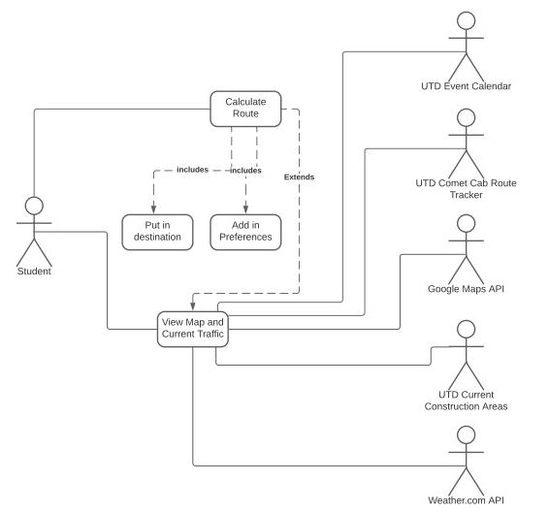
Use Case Diagram
Notes:
Adam Wajahat

Slide 8
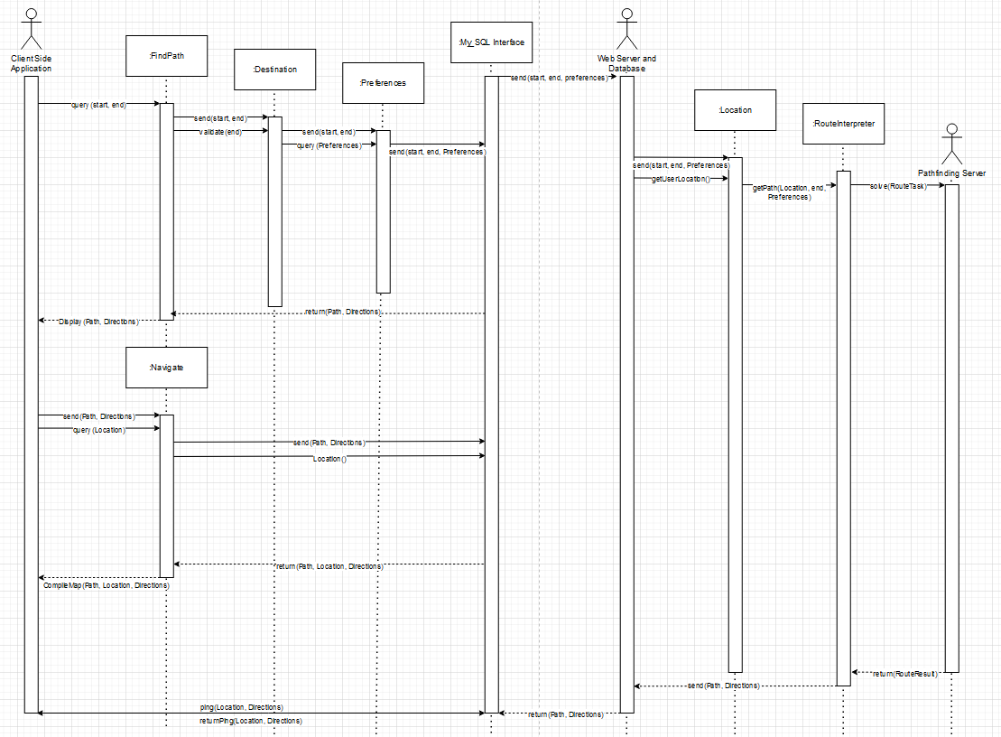
Sequence
Diagram
Notes:
William Bumpass
For this sequence diagram, we built the main routing algorithm that the program uses. When receiving a request for a path, shown by user inputed start and end points, the program will pass these through a validation function to check if both the start and end points exist.
Assuming both the start and end points exist, the program accepts a list of user preferences for the path by which to restrict certain paths. This can be anything from wheelchair disability to preferring indoors, though construction and other detours NOT based on preferences are automatically included.
After passing this through to a route interpreter and generating the best path for the user, it returns it and displays it for the user.
Periodically, as the user walks along the path, their location will be updated and new paths will be generated. This allows for updates in the path to occur, changing the path if the user takes the wrong path and needs to reorient themselves.
Next is Benjamin with the Class Diagram

Slide 9
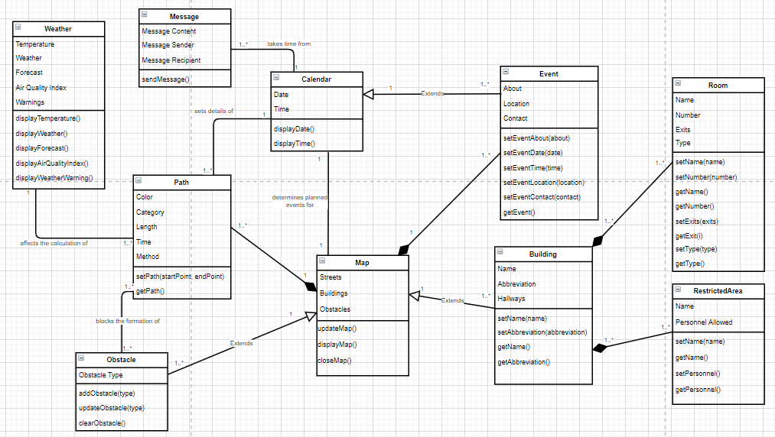
Class
Diagram
Notes:
Benjamin Rubarts

Slide 10
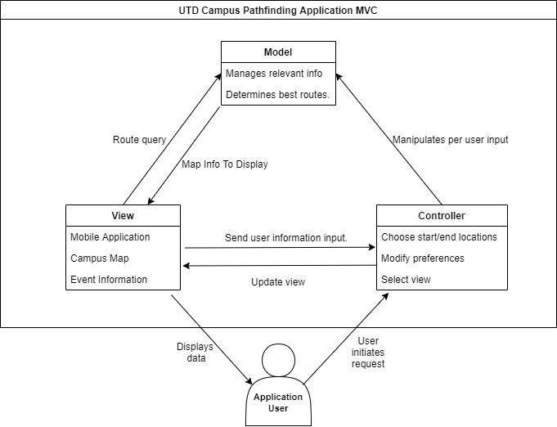
Architectural Diagram
[5]
Notes:
Michael Villordon: For the architectural design, our team elected to do the Model-View-Controller design scheme. The MVC design scheme allows us to split up and handle complex user and database interactions via the model, view and controller sections. \
So we can handle user inputs and route mapping through the model and view, managing all relevant info, determining the best route, and displaying that to the view.
Thus, the view would be able to display the campus map, the route overlay, and any other relevant information.
The model would be able to take input from the view and controller, using the user’s preferences and inputs to manipulate information upon a route query, and sending the proper mapping information to the view. The controller can handle the complex user inputs and preferences, modifying those and updating the view and manipulating the model given user input.
This concludes our presentation, thank you.

Slide 11
References
[1]Google. [Online]. Available: https://developers.google.com/search/apis/indexing-api/v3/quota-pricing. [Accessed
08-Nov-2020].
[2]“Calendar API | Google Developers,” Google. [Online]. Available: https://developers.google.com/calendar. [Accessed
08-Nov-2020].
[3]“EULA,” Centrify. [Online]. Available: https://www.centrify.com/eula/. [Accessed 08-Nov-2020].
[4]“Exam 70-486: Developing ASP.NET MVC Web Applications,” Microsoft. [Online].
Available: https://docs.microsoft.com/en-us/learn/certifications/exams/70-486. [Accessed Nov. 1, 2020].
[5]“MVC Design Pattern,” GeeksforGeeks, 08-Feb-2018. [Online]. Available:
https://www.geeksforgeeks.org/mvc-design-pattern/. [Accessed 08-Nov-2020].

